Slide 1

HOSPITALITY MANAGEMENT SYSTEM
Presented by:
BOKKA PRAVEEN KUMAR
VINITHA SRI PRATHIPATI

Slide 2
Problem Statement:
The current hospitality service process is mostly manual, slow, and uncoordinated. Customers often face delays in getting their requests or complaints addressed, and there is limited tracking of ongoing services. Staff members spend considerable time managing service records, assigning tasks, and following up on issues — all of which can lead to inefficiencies and inconsistent guest experiences.
Proposed Solution:
The Hospitality Management System automates service request registration, complaint handling, task routing, and status tracking. It streamlines the entire hospitality workflow by allowing receptionists to log requests, automatically route them to the appropriate team based on skills, monitor SLAs, and ensure timely completion. Developed using the Pega platform, the system enhances operational efficiency, reduces manual errors, and ensures faster response times for improved customer satisfaction.

Slide 3
Objectives :
Provide a single platform for receptionists to record customer service requests and complaints.
Help trip managers and service executives manage and track all customer interactions efficiently.
Enable real-time updates and clear tracking of service and complaint status.
Offer reports and dashboards for management to monitor service quality and resolution timelines.
Reduce manual work by automating the entire hospitality workflow through case management and SLA tracking.

Slide 4
Scope :
Register and manage customer details and service records.
Log and track service requests and complaints efficiently.
Monitor the status of each request (Pending, In Progress, Completed, or Resolved).
Send real-time notifications and updates to customers upon completion of services.
Automatically route service requests or complaints to the appropriate team based on skill and role.
Track service and complaint performance statistics and generate detailed reports for management review.

Slide 5
Tools Used :
Tool | Usage
Pega Platform | To build the entire application and manage the flow of processes.
Pega Constellation | To create a simple and modern user interface.
Pega Case Management | To manage each step such as customer registration, service request, complaint handling, and feedback collection as separate cases for better tracking and control.
Pega Decision Rules | To automatically route service requests and complaints to the right department or staff member based on skill and role.
Pega Reports | To display service performance, complaint statistics, and resolution timelines in detailed reports.

Slide 6
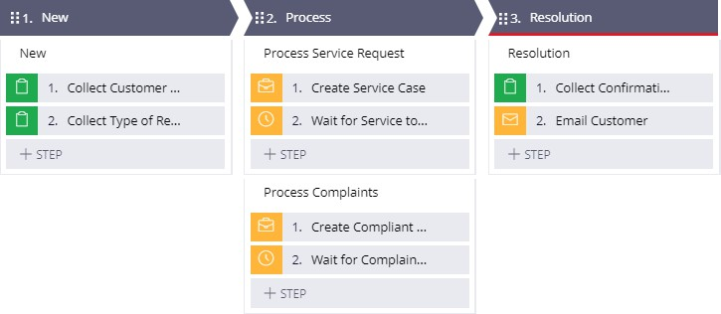
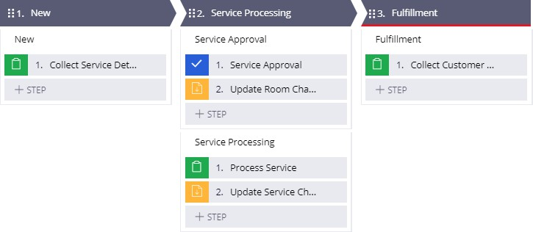
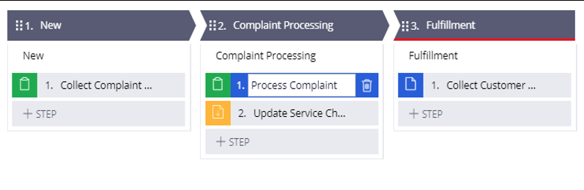

Slide 7
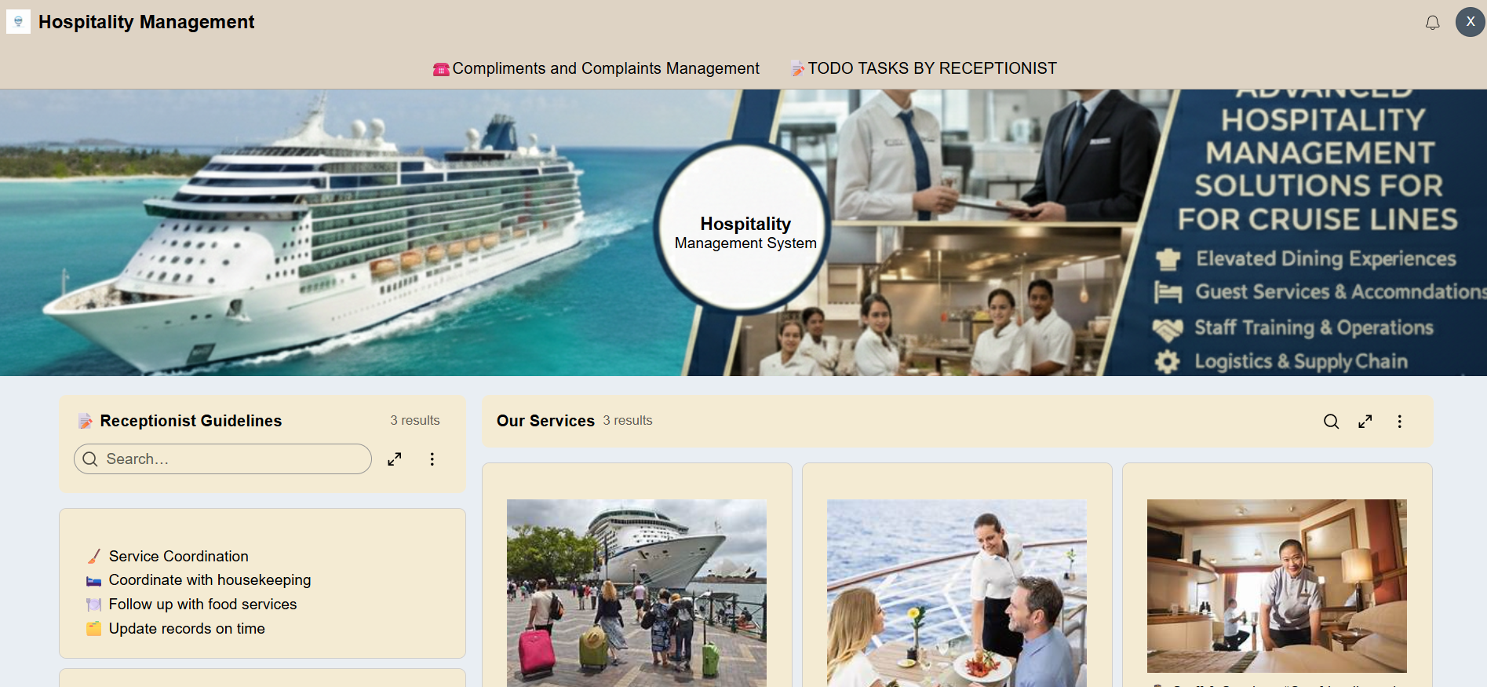
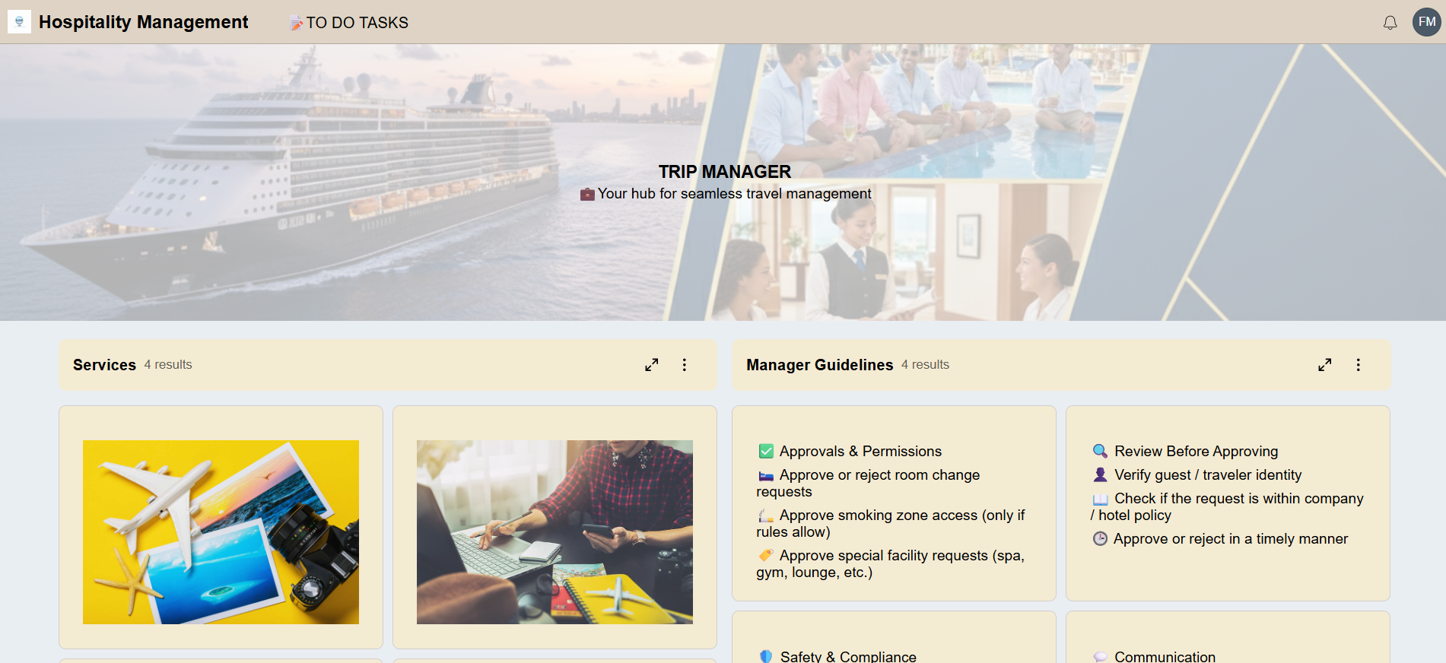
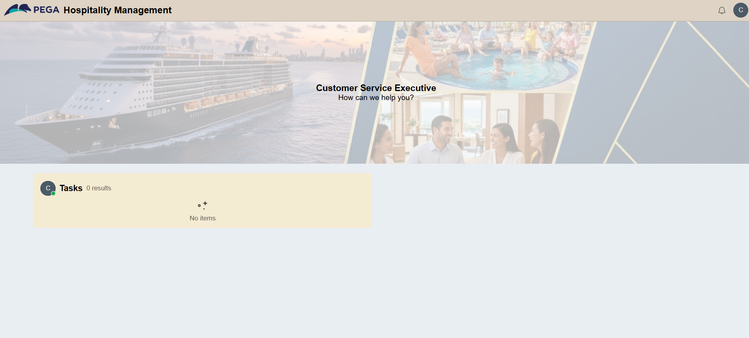
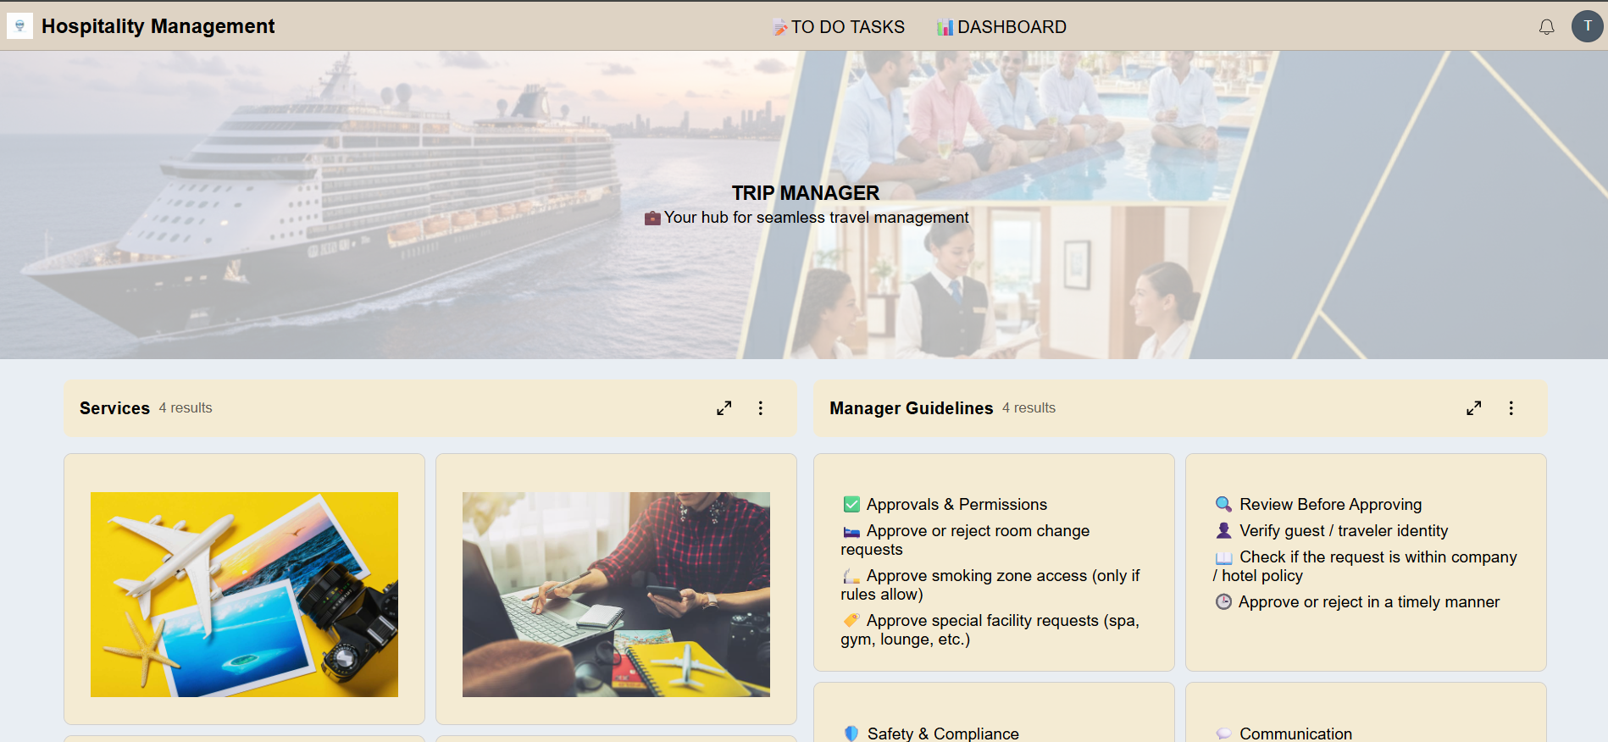
Progress Made :
Developed four main portals — Receptionist, Customer Service Executive, Trip Manager, and Food Manager — to manage service requests, complaints, and approvals efficiently within the Hospitality Management System.

Slide 8
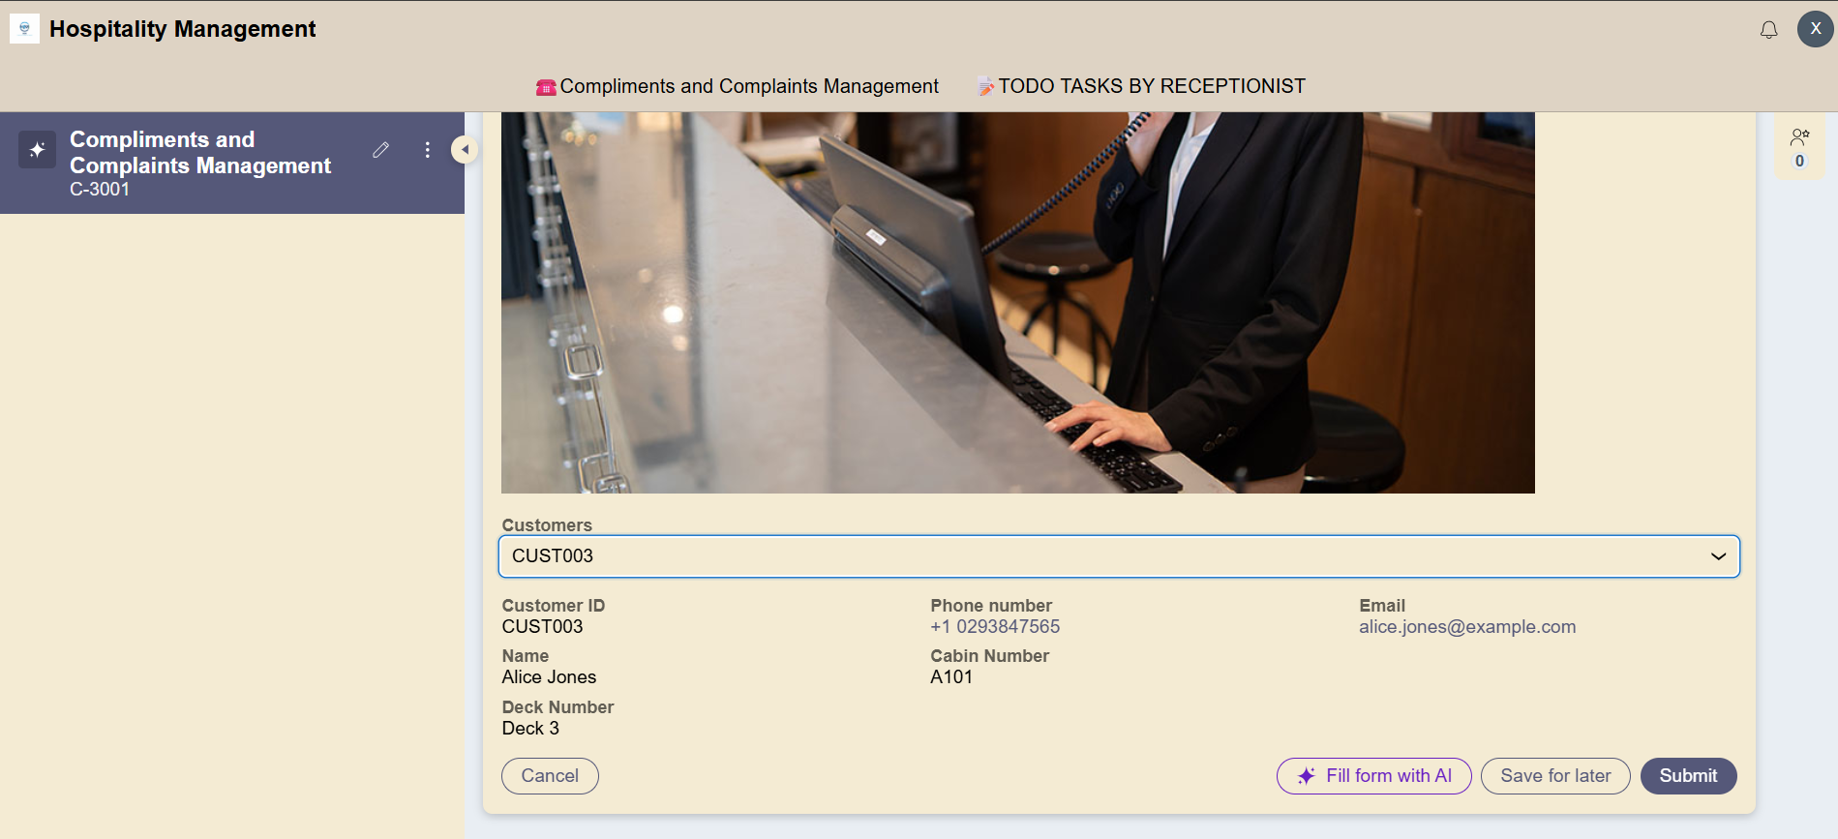
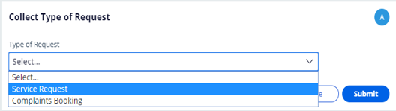
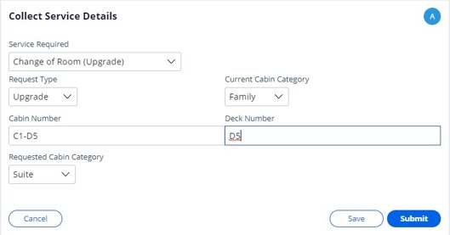
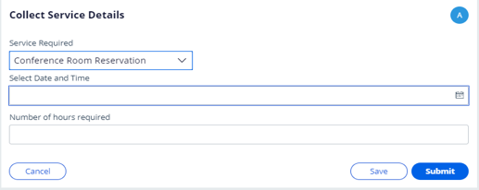
Service Request Screens:

Slide 9
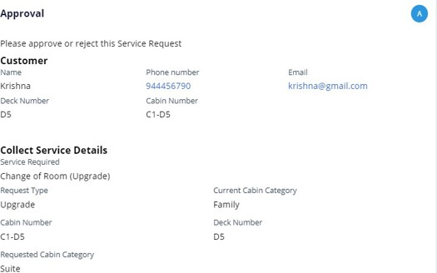
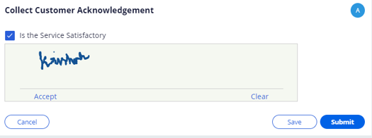
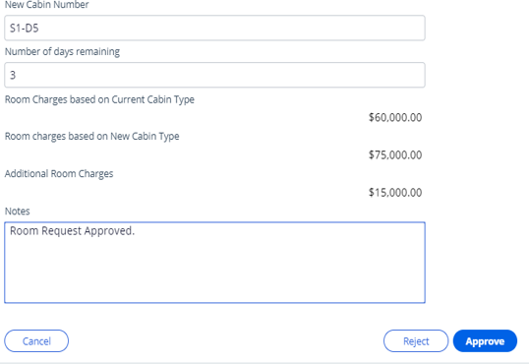
Approval Screens:

Slide 10
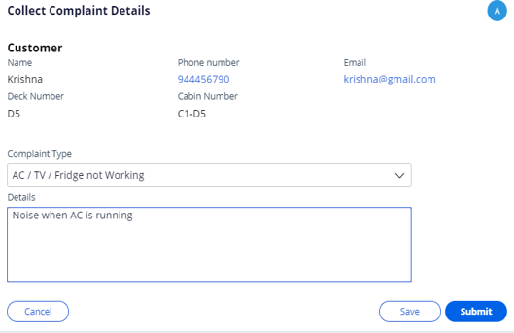
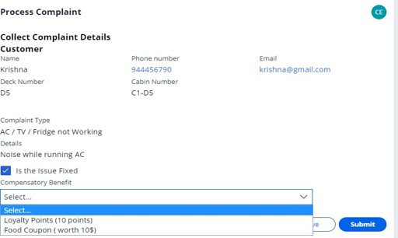
Complaint Booking Screens:

Slide 11
Challenges Faced :
• Designing complex case lifecycles and routing logic for complaints and services. • Synchronizing data between customer profiles and service records. • Managing different access roles for receptionists, service staff, and managers. • Configuring real-time notifications and SLA alerts. • Maintaining UI consistency across multiple user roles.

Slide 12
Conclusion: The Hospitality Management System automates and streamlines hospitality workflows, ensuring faster service, efficient complaint handling, and improved customer satisfaction. Future Scope: • Develop mobile apps for staff and customers. • Integrate with CRM or payment systems. • Implement AI-based smart routing. • Enhance analytics and reporting capabilities.

Slide 13
THANK YOU

